Slide 1
Communicable disease awareness presentation
Division of Training and Development
Department of human resources
Dr. Cindy Hickman, Ed.D. Director Training and development
in cooperation with:
Cumberland County Department of Health
Cumberland County Office of Emergency Management
August 2022
data is evolving and subject to change as new guidelines are updated

Slide 2
Agenda
Standard precautions to prevent the spread of communicable disease in the workplace
Departmental SOPs
References

Slide 3
Simple ways to prevent spread of communicable disease in our workplace
Stay home if you are sick/not feeling well.
Wear a mask!
Wash hands frequently! Soap + water – at least 20 seconds.
Use hand sanitizer. See Department Head for supplies.
Do not touch your eyes, nose, or mouth without cleaning your hands first.
Make sure your workplaces are clean and hygienic
Routinely wipe down frequently touched surfaces like your desk, telephone, keyboard, mouse, etc.

Slide 4
Hand Hygiene to stop the spread of communicable disease
Employees should wash hands often with soap and clean, running water for at least 20 seconds (Sing Happy Birthday x2!)
Hand sanitizer can be used if you aren't around a sink with soap and water – use one that is at least 60% alcohol.
Do not use hand sanitizer if hands are sweaty or visibly dirty – that can dilute the effectiveness of the hand sanitizer.
When in doubt, wash your hands!

Slide 5
When to wash your hands
Before and after putting on your mask
After blowing your nose, coughing, or sneezing
Before, during, and after preparing food
After using the toilet
After touching garbage
Before and after your work shift
Before and after a work break
After touching any object that is not yours

Slide 6
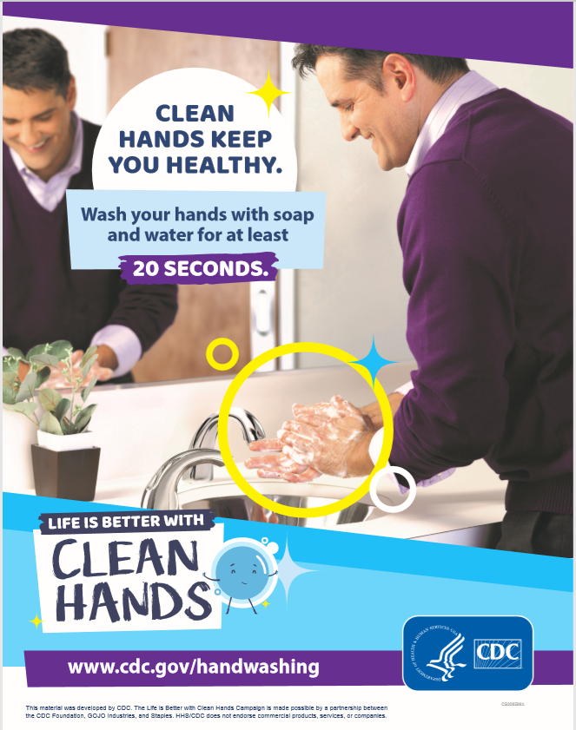
CDC - Life is Better with Clean Hands Campaign
WHO - Clean Care is Safer Care

Slide 7
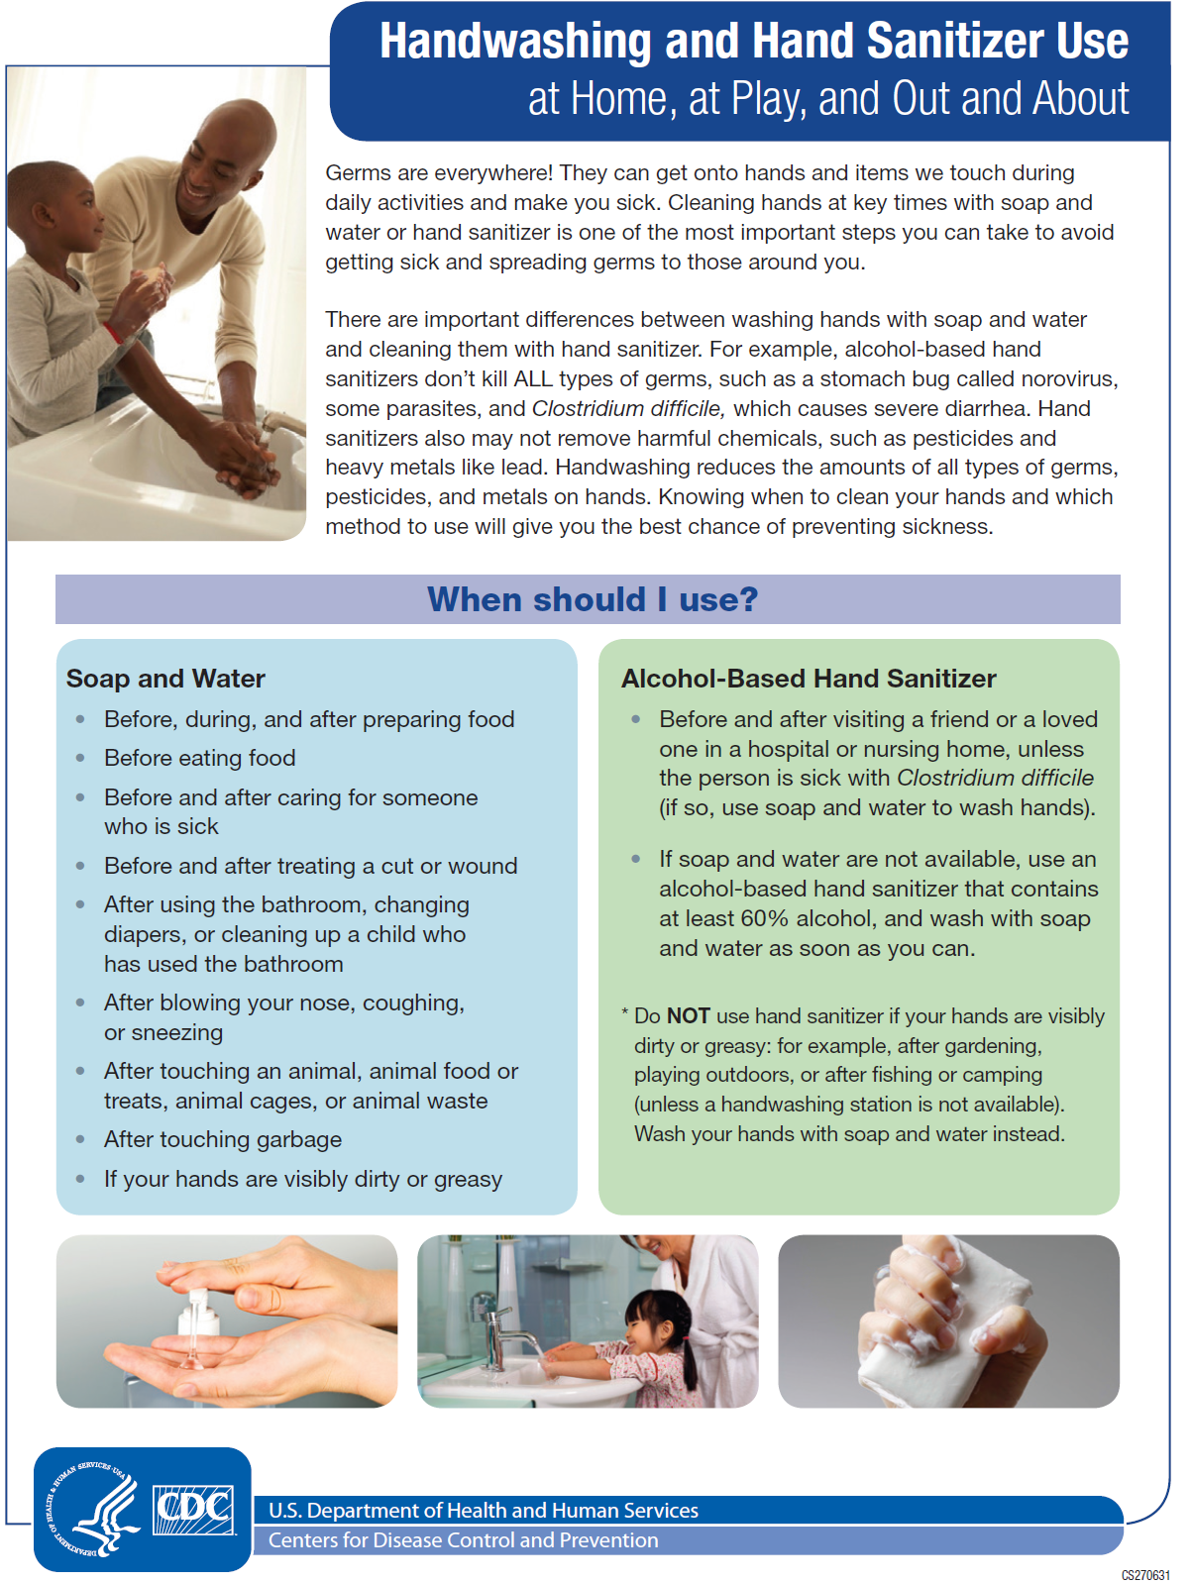
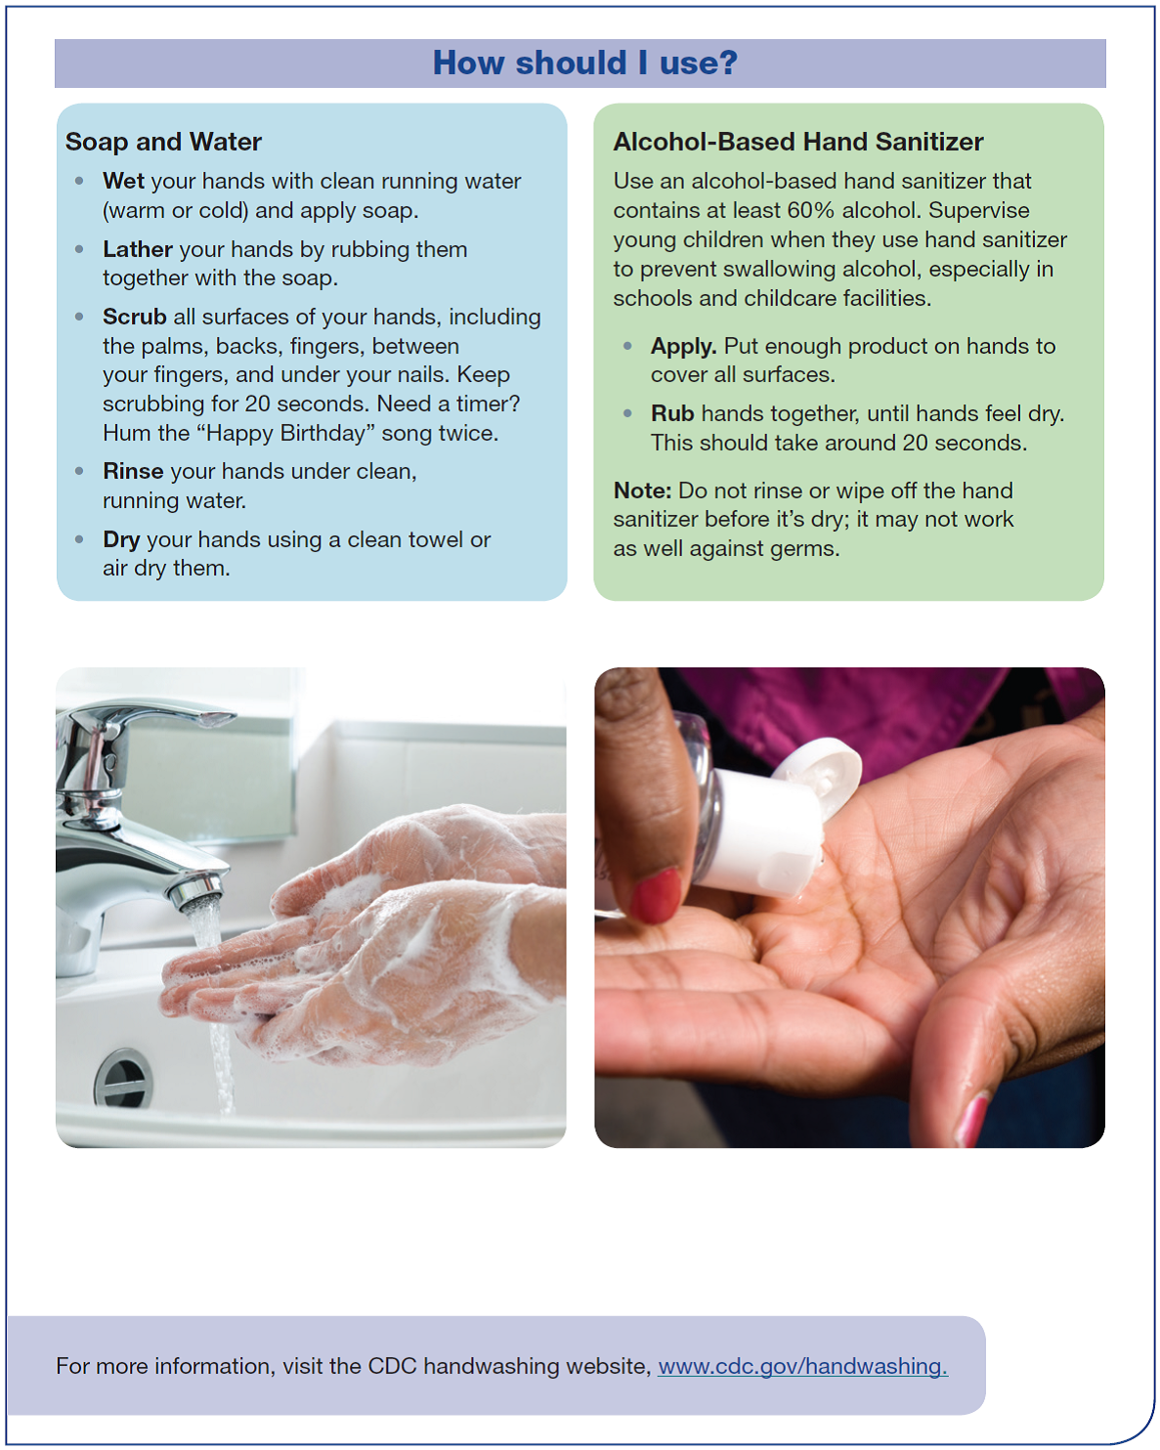

Slide 8
Stay at home if you are sick!
We all play a part to stop the spread of communicable disease.
If you are not feeling well, staying home is the best thing you can do for yourself and your coworkers.
Staying home (even if you feel like you could "push through it") will make sure the virus cannot spread.
At home you can monitor your symptoms, increase fluids, and wash your hands frequently.

Slide 9
Face Masks in the workplace
Face masks are not required to be worn while at work,.
You can choose to wear a face mask to work.
PPE like surgical masks and respirators are essential for frontline medical workers (like those working with communicable disease patients).
If you choose to wear a mask you should be made of two breathable layers, and you should wash your hands (or use hand sanitizer) before and after putting your mask on.
To learn how to select, wear, and clean your masks appropriately, visit https://www.cdc.gov/coronavirus/2019-ncov/prevent-getting-sick/diy-cloth-face-coverings.html

Slide 10
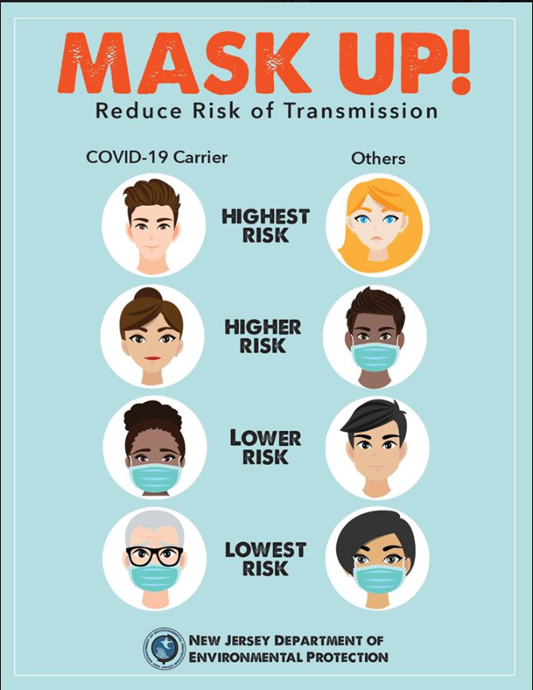

Slide 11
Kitchen hygiene apply these rules any time and all the time!
Clean high touch surfaces (handles, buttons, tables, sinks) frequently with disinfectants
Clean visibly dirty surfaces with soap and water
Wash your hands before using the kitchen area. This is the best way to prevent you from getting sick.
Do your food prep at home. Only use the kitchen area to heat up your lunch not prepare it.
Wash and sanitize mugs, cups, silverware, etc. At home.
Coffee mugs, water bottles, utensils, plates, etc. that have been used by an individual should be taken home and washed daily.
Always follow label directions when using chemical cleaners and disinfectants.

Slide 12
Workplace meetings or fieldwork
Whenever practical, hold virtual meetings hosted online or by phone and practice social distancing (as per email from Paige Desiere, Director of Personnel and Human Resources on 5/31/2022
If you do need to meet in person;
Sanitize or wash your hands when the meeting or fieldwork is over

Slide 13
how to protect yourself and others
See link below from the CDC
https://www.cdc.gov/coronavirus/2019-ncov/prevent-getting-sick/prevention.html

Slide 14
What is a close contact?
A close contact is defined as 15 cumulative minutes (meaning total time when added) or more of exposure at a distance of 6 feet or less to an infected person during a 24 hour period in which the infected person is infectious.

Slide 15
What is contact tracing?
In New Jersey, there is a list of contagious diseases health departments must investigate, by law, within a certain time period. The investigation can be different for these diseases based upon the severity of the disease and the potential to infect others.
Contact tracing is the process used to identify those who have come into contact with people who have tested positive for a contagious diseases in order to inform them, provide guidance, and offer support. Contact tracing is a long-standing practice in New Jersey and around the world.
Once someone tests positive for a contagious disease, the Health Department may ask that person if they have any contacts. The definition of “contact” can change between diseases. If contacts are identified, the health department will follow up with those contacts as required by law.
Contacts receive a phone call from the health department to start the interview process.
PLEASE NOTE: Contact Tracers will NEVER ask you for your social security number, financial information, or immigration status. If you are asked any questions like this, please report it to NJ Division of Consumer Affairs.

Slide 16
Quarantine vs. isolation: What is the difference?
Quarantine
Quarantine means to separate and restrict the movement of people who were exposed to a communicable disease.
While in quarantine, you should stay home and away from others.
Isolation
Isolation means to separate sick people who have a communicable disease from people who are not sick.
While in isolation, you should stay away from everyone (and use your own facilities, household items, etc.)

Slide 17
Specific Department SOP’s
Always refer to the department’s Standard Operating Procedures (SOPs) as it relates to reentry, if you have questions
Contact your supervisor if you are still unsure after consulting the SOP

Slide 18
PERSONAL PROTECTION EQUIPMENT DONNING AND DOFFING
Next two slides

Slide 19
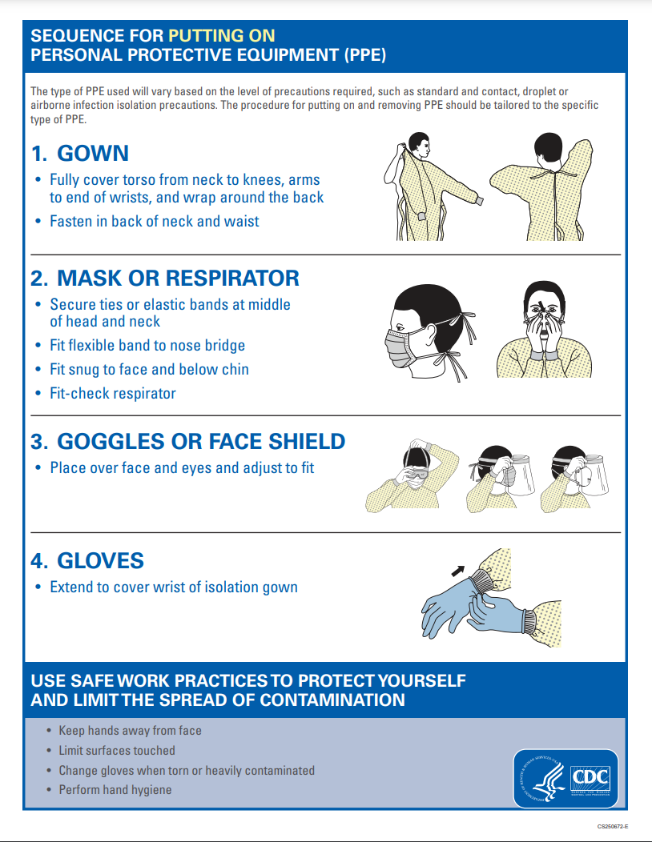

Slide 20
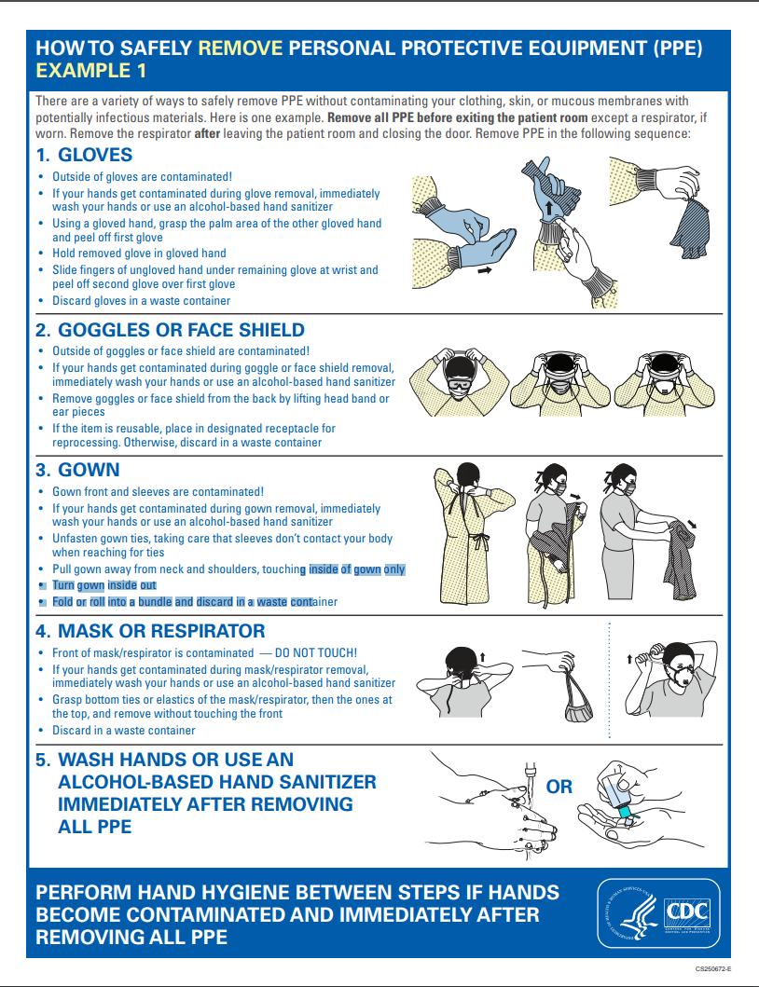

Slide 21
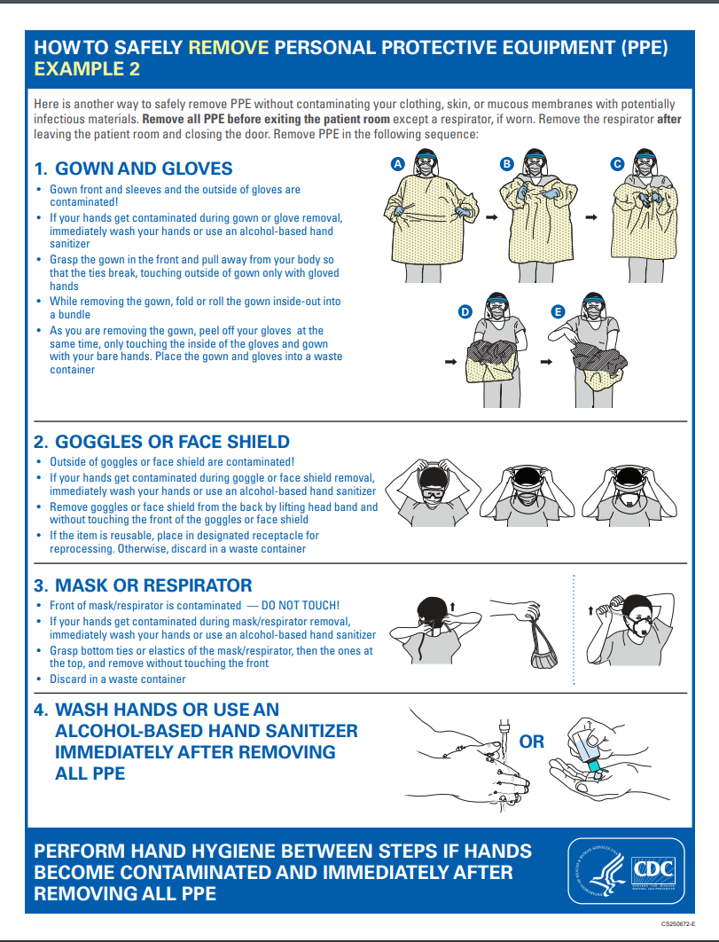

Slide 22
Special acknowledgements
Would like to thank the following departments for assisting in preparing this training module:
Cumberland County Health Department
Office of Emergency Management
Office of Veteran Affairs

Slide 23
References
Employment Opportunity Commission (April 7, 2020) retrieved from https://www.eeoc.gov/eeoc/newsroom/wysk/wysk_ada_rehabilitaion_act_coronavirus.cfm and All EEOC materials related to COVID-19 are collected at www.eeoc.gov/coronavirus.
NJ Department of Labor information and data retrieved from https://www.nj.gov/labor/worker-protections/earnedsick/covidFAQ.shtml and https://www.dol.gov/agencies/whd/pandemic/ffcra-employer-paid-leave.

Slide 24
references
CDC Cloth Face Coverings
https://www.cdc.gov/coronavirus/2019-ncov/prevent-getting-sick/diy-cloth-face-coverings.html

Slide 25
THIS TRAINING IS UPDATED AS OF AUGUST 2022.
DATA IS EVOLVING AND SUBJECT TO CHANGE AS NEW GUIDELINES ARE UPDATED.

