Slide 1
Employee Assistance Program
Caring for the Caregiver
Presented by Shaunta Clark
www.charlesnechtem.com
Notes:
Welcome. I’m happy to be with you today to tell you about the EAP services as employees with ________________.
Some of you may have personally utilized EAP services at some time in your work life and for some of you, the whole concept may be new, so I’m going to spend a moment talking about the purpose of EAP and how to utilize the various services offered.
Think about when you’re are feeling good physically and mentally. How does feeling good affect your ability to cope with personal, family and work problems?
When you’re feeling good, you have the tools to cope. You have (1) the resilience to adapt to change, (2) you’re more satisfied with your life; and (3) you can accomplish more on the job.
When employees utilize their free EAP services, their problems are “nipped in the bud.” EAP can help prevent all those complications - and the suffering - that can happen when issues are not addressed – things like anxiety, panic, depression, and possibly worse - mental illness and substance abuse.
Think of your EAP as a service that (1) promotes well-being; and (2) prevents the loss of productivity that can result when your employees’ lives are out of balance because of stress, family issues, marital issues, personal difficulties, substance abuse or any of a wide variety of life’s challenges.
As we continue this presentation, you’ll learn about the
EAP services provided by CNA for ALL employees and their household family members.
,

Slide 2
Employee Assistance Program
1-800-531-0200
24 Hour Confidential Support Service
English, Spanish, and all other languages
Over 100,000 therapists in-network
Face-to-face counseling sessions for employees and household family members
E-Counseling and Comprehensive, User-Friendly Website and Mobile App
IMMEDIATE access to counselors without the use of hold services
Masters and Ph.D. level clinicians and nurses with a minimum of 5 years experience
Provide referrals to specially trained clinicians with follow-up services
Hand-held resource referral
www.charlesnechtem.com
2
Notes:
The Employee Assistance Program is a benefit offered to all employees and “household family members” that offers a wide array of EAP, Wellness, and Work/Life services. These include:
24-hour confidential support by phone, 365 days per year.
We have counselors who speak French and Spanish and can provide translation for all other languages.
A counselors answer each and every call. No appointments are needed for telephone counseling, and no one is placed on hold. You never have to talk to a clerk who will put you on hold nor wait for a return call. You never get have to press this or that number to get to the person you need to talk to.
Our counselors have a Master’s or PhD and a minimum of 5 years experience in the counseling field. Each is able to provide immediate confidential assessment and counseling addressing problems of any kind.
You can opt for telephone counseling or a referral to therapists within 10 miles of your address of choice for face-to-face counseling. We also refer callers to therapists in the caller’s insurance network.
Some employees want to see a counselor recommended by a health provider or even a friend. If this provider is not in the CNA network, Provider Relations employees will contact the counselor and invite him or her to join the CNA network. This is done very quickly. We have a proven track record of verifying and confirming a provider’s credentials and specialty areas of practice within a 24hr period, accommodating the needs of our client while assuring quality of care.
CNA has over 100,000 therapists in our network and CNA EAP counselors will make the greatest effort to make sure each caller is satisfied with their therapist.
There’s more information on our provider network later in the presentation.
Your EAP counselor supports you through the referral process make sure the therapist to whom you are referred is a good match.
E-Counseling is therapeutic communication that takes place over the Internet. The written form of communication is very flexible and allows a counselor and client to 'meet' any time no matter where the two are located on the globe. There are pros and cons to this form of communication, and it does not appeal to everyone. Yet for people who do access eCounseling, it offers convenience, confidentiality, and a way to 'compose themselves.' Writing also allows for introspection and you automatically have a journal of the experience to reread, which can be very helpful.

Slide 3
On-staff Clinicians Experience
Adoption
ADHD
Anger Management
Anxiety/Panic/Stress
Autism
Child/Adolescent/Family
Depression
Developmental Disabilities
Disability
Domestic Violence
Eating Disorders
Fitness for Duty
Gambling
Gay/Lesbian/Transgender
Grief
Group Counseling
Job Performance/Interpersonal Conflicts
Marital/Relationship/Family/Divorce
Medical Concerns/Problems
Mental Health Disorders
Parenting Issues
PTSD
Self-Esteem
Sexual Abuse/Rape
Sexual Issues/Gender Identity
Substance Abuse
Suicidal Ideation
Workplace Conflict or Violence
www.charlesnechtem.com
2

Slide 4
Employee and/or Supervisor
“Household” Family Member
EAP Helpline 800-531-0200 www.charlesnechtem.com CNA Assistance App
EAP Counselor Assessment Short-term Counseling
Community Resources Marriage/Family Counseling Financial Counseling Outpatient Mental Health Treatment Legal Counseling Outpatient Alcohol/Drug Treatment
www.charlesnechtem.com
2
Notes:
Whenever you recognize that you or some you know is struggling with something in life and need to talk with someone, all anyone needs to do is call the EAP by using the toll-free number (which is 1-800-531-0200). Once you dial that number, you are automatically connected to a live counselor – someone who is available immediately help you with your issue. Employees (clients) may request to speak with the same counselor (if available) every time you call so that you don’t have to tell your story every time you call.
If either you or your EAP counselor feel that in person counseling or other support resources would be more beneficial to you, then the counselor will work with you to arrange that level of support. We offer referrals for financial counseling, legal services, and of course for mental health services such individual and family counseling, and to outpatient/inpatient treatment facilities.
The EAP counselor will ask questions like where you would like the therapist to be located (what town or zip code); whether you prefer a type of counselor (male or female or other specifications); and if there is a time of day that fits best into your schedule.
Through the EAP, employees and their household family members are eligible for counseling visits with a local practitioner at no cost. We want to make sure that you can continue with the same therapist without having to worry about changing providers or what your out-of-pocket cost will be and for this reason we ask for insurance provider information.
Also know that once you begin the in-person counseling, you are still able to contact the EAP for additional support or services.

Slide 5
EAP Network Providers
Certified and licensed social workers, counselors and psychologists
Expertise in diagnosis, crisis intervention and substance abuse
Minimum 5 years in private practice in good-standing
Same-day appointments for emergencies
www.charlesnechtem.com
2

Slide 6
Additional Services
Critical Incident Stress Debriefing (CISD)
Seminars/workshops
CNA website and on-line wellness library
CNA Assistance mobile app
Mandatory referrals
www.charlesnechtem.com
2

Slide 7
CNA Website and Self-Help Wellness Library
CNA website addresses physical, emotional, and mental well-being
Visit www.charlesnechtem.com
Text us and/or schedule virtual appointments with an EAP counselor at your convenience
Submit your therapist referral questionnaire and the counselor will send you up to 3 match therapists via your preferred contact method
Our self-help Wellness Library provides direct access to information on over 25,000 articles that are continuously updated. To login:
Go to website: www.charlesnechtem.com
Select “Member”
Login if you are a new member, or register as new user
www.charlesnechtem.com
2
Notes:
On-Line Wellness Library Access: - Our website, www.charlesnechtem.com, has a wealth of helpful information for employees, including over 250,000 articles regarding tips on health, wellness, emotional, legal and financial issues, and child and elder care issues. These articles are updated on a monthly basis and offer support in all areas of life.

Slide 8
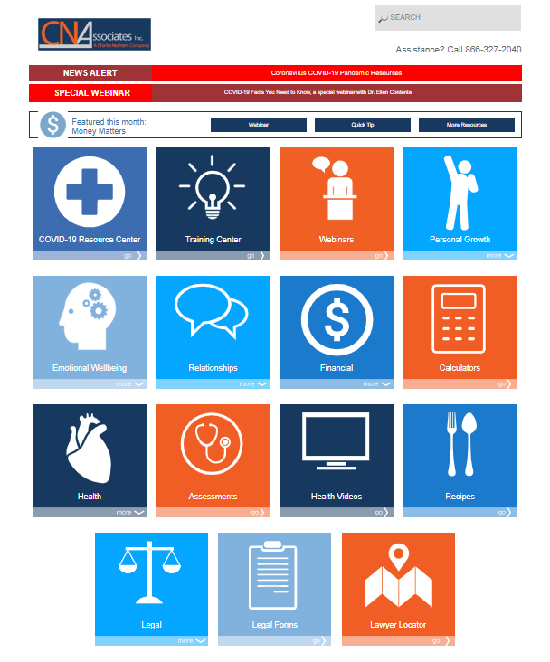
www.charlesnechtem.com
2
Notes:
This is just a sample of what you would see when you log into our library.

Slide 9
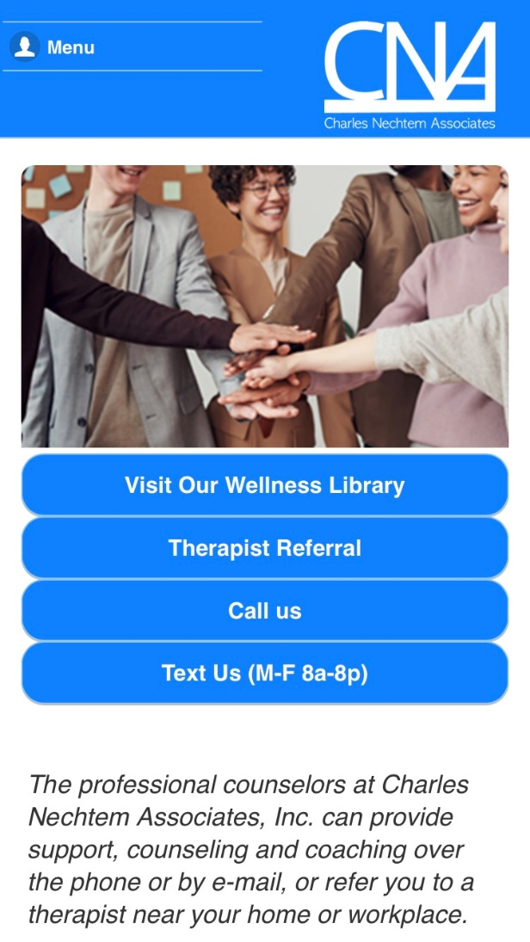
Mobile APP: Feature
Call Us 24/7 at 800-531-2040
Email your concern at inquires@charlesnechtem.com
Text us and/or schedule a virtual appointment with and EAP counselor at your convenience
Submit your therapist referral questionnaire and the counselor will send up to 3 matched therapists via your preferred contact method
Access interactive self-help wellness library with 25,000 resources
*CNA Assistance Apps are available at the Apple Store and Google Play
www.charlesnechtem.com
2

Slide 10
Employee Assistance Program
1-800-531-0200
www.charlesnechtem.com
Notes:
Our EAP and Work/Life services and procedures provide early, skilled intervention that includes easy access, rapid response, accurate diagnosis, problem resolution, timely referrals, and education.
Thank you for your time and don’t hesitate to call us with any questions you may have!

