Slide 1
Employee Assistance Program (EAP)
Presented by Shaunta Clark
www.charlesnechtem.com
Notes:
Welcome. I’m happy to be with you today to tell you about the EAP services for you and your employees.
Some of you may have personally utilized EAP services at some time in your work life and for some of you, the whole concept may be new, so I’m going to spend a moment talking about the purpose of EAP and how to utilize the various services offered.
Think about when you’re are feeling good physically and mentally. How does feeling good affect your ability to cope with personal, family and work problems?
When you’re feeling good, you have the tools to cope. You have (1) the resilience to adapt to change, (2) you’re more satisfied with your life; and (3) you can accomplish more on the job.
It works the same way for your employees. When your employees utilize their free EAP services, their problems are “nipped in the bud.” EAP can help prevent all those complications - and the suffering - that can happen when issues are not addressed – things like anxiety, panic, depression, and possibly worse - mental illness and substance abuse.
So, in your role as a supervisor, think of your EAP as a service that (1) promotes well-being; and (2) prevents the loss of productivity that can result when your employees’ lives are out of balance because of stress, family issues, marital issues, personal difficulties, substance abuse or any of a wide variety of life’s challenges.
As we continue this presentation, you’ll learn about the
EAP services provided by CNA,
What are some warning signs of an employee who is need of support
How to refer employees for EAP services,

Slide 2

Employee Assistance Program
1-800-531-0200
    24-hour confidential support
    services
    English, Spanish, French, and
    translation services for all other
    languages
    Up to 3 virtual or in-person
    sessions with a local provider.
    100,000 in-network providers in
    North America and the UK. We provide
    referrals within 10 miles radius of
    a provided zip or postal code
  E-counseling and user-friendly website accessibility plus mobile app
  IMMEDIATE access to counselors without the use of hold services
  Masters and Ph.D. level clinicians with a minimum of 5 years experience
  Provides referrals to specially- trained clinicians with follow-up services
  Hand-held resource referral
www.charlesnechtem.com
2
Notes:
The Employee Assistance Program is a benefit offered to all employees and “household family member” that offers a wide array of EAP, Wellness, and Work/Life services. These include:
24-hour confidential support by phone, 365 days per year.
We have counselors who speak French and Spanish and can provide translation for all other languages.
A counselors answer each and every call. No appointments are needed for telephone counseling, and no one is placed on hold. You never have to talk to a clerk who will put you on hold nor wait for a return call. You never get have to press this or that number to get to the person you need to talk to.
Our counselors have a Master’s or PhD and a minimum of 5 years experience in the counseling field. Each is able to provide immediate confidential assessment and counseling addressing problems of any kind.
You can opt for telephone counseling or a referral to therapists within 10 miles of your address of choice for face-to-face counseling. We also refer callers to therapists in the caller’s insurance network.
Some employees want to see a counselor recommended by a health provider or even a friend. If this provider is not in the CNA network, Provider Relations employees will contact the counselor and invite him or her to join the CNA network. This is done very quickly. We have a proven track record of verifying and confirming a provider’s credentials and specialty areas of practice within a 24hr period, accommodating the needs of our client while assuring quality of care.
CNA has over 100,000 therapists in our network and CNA EAP counselors will make the greatest effort to make sure each caller is satisfied with their therapist.
There’s more information on our provider network later in the presentation.
Your EAP counselor supports you through the referral process make sure the therapist to whom you are referred is a good match.
E-Counseling is therapeutic communication that takes place over the Internet. The written form of communication is very flexible and allows a counselor and client to 'meet' any time no matter where the two are located on the globe. There are pros and cons to this form of communication, and it does not appeal to everyone. Yet for people who do access eCounseling, it offers convenience, confidentiality, and a way to 'compose themselves.' Writing also allows for introspection and you automatically have a journal of the experience to reread, which can be very helpful.

Slide 3
EAP STATISTICS
PRIMARY ISSUES
www.charlesnechtem.com
2
Notes:
Here at the EAP we encounter lots of different issues and can assist callers in working through multiple life circumstances. Primarily at the EAP, though we work with Psychological stressors (such as stress, depression and anxiety); marital and family issues, child problems (like problems at school and behavioral issues); and substance abuse issues (for self and regarding other’s use). “Other” issues may be related to legal, financial, housing etc.

Slide 4
  On-staff Clinicians Experience
  Adoption
  ADHD
  Anger Management
  Anxiety/Panic/Stress
  Autism
  Child/Adolescent/Family
  Depression
  Developmental Disabilities
  Disability
  Domestic Violence
  Eating Disorders
  Fitness for Duty
  Gambling
  Gay/Lesbian/Transgender
  Grief
Group Counseling
Job Performance/Interpersonal Conflicts
Marital/Relationship/Family/Divorce
Medical Concerns/Problems
Mental Health Disorders
Parenting Issues
PTSD
Self-Esteem
Sexual Abuse/Rape
Sexual Issues/Gender Identity
Substance Abuse
Suicidal Ideation
Workplace Conflict or Violence
www.charlesnechtem.com
2

Slide 5
Employee and/or Supervisor
“Household” Family Member
EAP Helpline 800-531-0200 www.charlesnechtem.com CNA Assistance App
EAP Counselor Assessment Short-term Counseling
Community Resources Marriage/Family Counseling  Financial Counseling  Outpatient Mental Health Treatment Legal Counseling  Outpatient Alcohol/Drug Treatment
www.charlesnechtem.com
2
Notes:
Whenever you recognize that you or some you know is struggling with something in life and need to talk with someone, all anyone needs to do is call the EAP by using the toll-free number (which is 1-800-531-0200). Once you dial that number, you are automatically connected to a live counselor – someone who is available immediately help you with your issue. Employees (clients) may request to speak with the same counselor (if available) every time you call so that you don’t have to tell your story every time you call.
If either you or your EAP counselor feel that in person counseling or other support resources would be more beneficial to you, then the counselor will work with you to arrange that level of support. We offer referrals for financial counseling, legal services, and of course for mental health services such individual and family counseling, and to outpatient/inpatient treatment facilities.
The EAP counselor will ask questions like where you would like the therapist to be located (what town or zip code); whether you prefer a type of counselor (male or female or other specifications); and if there is a time of day that fits best into your schedule.
Through the EAP, employees and their household family members are eligible for 1-6 in person counseling visits at no cost to you. We want to make sure that you can continue with the same therapist without having to worry about changing providers or what your out of pocket cost will be and for this reason we ask for insurance provider information.
Also know that once you begin the in-person counseling, you are still able to contact the EAP for additional support or services.

Slide 6
EAP Network Providers
Certified and licensed social workers, counselors and psychologists
Expertise in diagnosis, crisis intervention and substance abuse
Minimum 5 years in private practice in good-standing
Same-day appointments for emergencies
www.charlesnechtem.com
2

Slide 7
Additional Services
      Critical Incident stress debriefing
      Seminars/workshops
      CNA website and on-line wellness library
      CNA Assistance mobile app
      Mandatory referrals
www.charlesnechtem.com
2
Notes:
In addition to counseling and referral services, our EAP offers clients additional services such as:

Slide 8
Critical Incident Stress Debriefing
  Contact/work directly with your Student Services and HR Department to call us and describe the event
  EAP Clinical Supervisor and Account Manager are immediately notified
  Urgent plan of action is developed
  Clinician is on-site within 24 hours (or upon request) to provide support
  On-site therapist offers emotional “first-aid” in group or individual sessions
www.charlesnechtem.com
2
Notes:
Critical Incident Stress Debriefing – You or Your employer feels that an incident has or will have a negative mental/emotional impact on employees, such as accidents on site, death/loss of employees, incident having an impact in the community where the company majority of works reside. The EAP will coordinate with the supervisor or HR representative to have a licensed therapist on site for support of employees with in 24 hours of the request or when scheduled.

Slide 9
Seminars/Workshops
  Anger management
  Coping with change
  Dealing with anxiety
  Dealing with depression
  Managing financial stress
  Excellence in supervision
  Family and relationship
  issues
  Meditation and relaxation
  Raising self esteem
  Resilience and change
  Setting and attaining goals
  Smoking cessation
  Stress management
  Teamwork and leadership
  Time management
www.charlesnechtem.com
2
Notes:
Seminars/Workshops -In addition to the orientation, CNA staff will develop customized employee and supervisory training programs on any topic to meet your needs and will collaborate with you to develop desired behavioral outcomes so that the training can be effectively assessed, and the learning reinforced. Examples of training topics include the following:, Managing Change, Stress Management, Developing Communication and Conflict Resolution Skills.

Slide 10
Mandatory Referrals
For employees with performance, reliability, or substance abuse problems, here’s the process:
  Mandatory referral letter, information form, and consent to release form. Forms are faxed to Charles Nechtem Associates (CNA)
  CNA assigns case manager who monitors adherence to the agreed-upon course of treatment
  CNA provides progress reports to the designated Supervisor or HR representative while maintaining compliance with confidentiality laws
www.charlesnechtem.com
2
Notes:
Mandatory Referrals - are implemented when an employee is not meeting the standards that have been set before them.
An employee is a mandated referral initiated by the employee’s supervisor to their HR rep. The employee is mandated to get counseling because the employee’s job is at risk. Usually, the employer may have given the employee a warning before the Mandated Referral is initiated. A Mandatory Referral offers the employee help and holds the employee accountable for learning how to stop the inappropriate behavior that led to the Mandatory Referral.
le of what you would see when you log into our library.

Slide 11
CHARACTERISTICS OF EMPLOYEES IN NEED
OF SUPPORT
www.charlesnechtem.com
2
Notes:
There are several warning signs of an employee needing support that supervisors should look for.
It is extremely important to understand that the following behaviors do not mean a person will become violent, but they may indicate that the person is experiencing high levels of stress. Each situation is unique and professional judgement or outside assistance may be necessary to determine if intervention is necessary.
It is much easier to prevent violence by stopping small incidents than trying to deal with the aftermath of a major crisis. Workplace violence can start as small incidents involving negative remarks and inappropriate behavior. It may escalate to physical or psychological violence.

Slide 12
Behavioral Signs
Physical Signs
Excessive absenteeism or lateness; difficulty with concentration and confusion
Marked decline in work performance; unsatisfactory work quality
Co-worker or customer complaints
Fatigue; personal hygiene is poor or ignored
Sudden and/or unpredictable change in energy level
Flushed or pale face, sweating
Pacing, restless, or repetitive movements
Signs of extreme fatigue, e.g., dark circles under the eyes
Clenched jaws or fists
Exaggerated or violent gestures
www.charlesnechtem.com
2
Notes:
Some Behavioral signs include - Excessive absenteeism or lateness. Difficulty with concentration and confusion, Marked decline in work performance Unsatisfactory work quality, Sudden and/or unpredictable change in energy level, Complaints of unfair personal treatment
Some Behavioral signs include - Pacing, restless, or repetitive movements, Signs of extreme fatigue (e.g., dark circles under the eyes), Clenched jaws or fists, Exaggerated or violent gestures, Change in voice, Loud talking or chanting, Scowling, sneering or use of abusive language.
Always take particular note if: -
There is a change in their behavior patterns.
The frequency and intensity of the behaviors are disruptive to the work environment.
The person is exhibiting many of these behaviors, rather than just a few.

Slide 13
Intervention and Referral
Steps to take when you have identified a performance issue:
Document the performance problem
Get yourself ready
Set the stage
Use constructive conversation
Refer for assistance
Follow up on progress towards meeting performance goals
www.charlesnechtem.com
2
Notes:
Effective intervention and referrals involve the following steps: read slide

Slide 14
What is documentation?
Taking notes to usually include date, time, place, who was involved, and what happened.
Why document?
Because we forget. Documentation is a tool to help us remember certain details and remain as objective as possible while making a fair and impartial assessment of job performance.
www.charlesnechtem.com
2

Slide 15
Getting Ready/Setting the Stage
Take deep breaths
Make sure the environment is safe for you and the employee
Distraction free meeting space
www.charlesnechtem.com
2
Notes:
It’s important that you prepare yourself for conversations with employees so that you can effectively express the issues. Be sure you… (read the slide)

Slide 16
Constructive Conversation
Share with the employee what the concerned are about his/her performance
State problem
Refer to documentation of specific events
Avoid over-generalizations
Ask for explanation
Avoid getting involved in discussions of personal problems
Try to get employee to acknowledge what you see as the problem
State what must be done to correct the problem
Set time frame for performance improvement
Specify consequences if problem continues
www.charlesnechtem.com
www.charlesnechtem.com
2
Notes:
Key Steps to constructive confrontation are as follows: Read Slide
Be Specific - Use concrete facts you have documented. Do not depend on second-hand reports or opinion.
Use Descriptive Statements - Avoid judging his/her behavior or motives.
Show Concern - Acknowledge and try to understand his/her feelings. Avoid sympathy which can have a condescending or an immobilizing effect.
Refer to the EAP - It is free and available to all employees… and most important it is Confidential.
16

Slide 17
CNA Website and Self-Help Wellness Library
CNA website addresses physical, emotional, and mental well-being
  Visit www.charlesnechtem.com
  Text us and/or schedule virtual appointments with an EAP counselor at your convenience
  Submit your therapist referral questionnaire and the counselor will send you 3 match therapists via your preferred contact method
Our self-help Wellness Library provides direct access to information on over 25,000 articles that are continuously updated. To login:
  Go to website: www.charlesnechtem.com
  Select “Member”
  Login if you are a new member, or register as new user
www.charlesnechtem.com
2
Notes:
On-Line Wellness Library Access: - Our website, www.charlesnechtem.com, has a wealth of helpful information for employees, including over 250,000 articles regarding tips on health, wellness, emotional, legal and financial issues, and child and elder care issues. These articles are updated on a monthly basis and offer support in all areas of life.

Slide 18
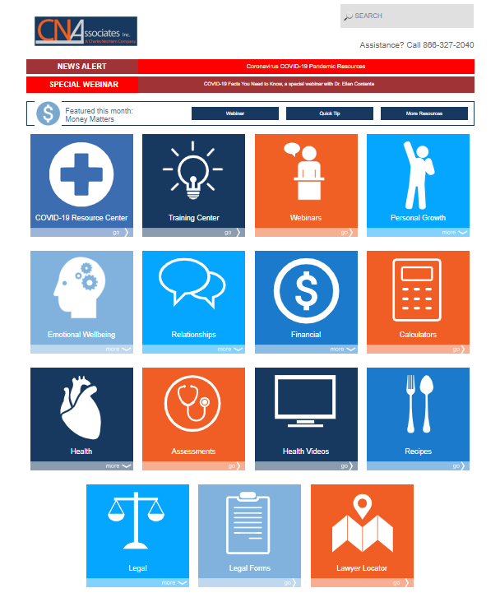
www.charlesnechtem.com
2
Notes:
This is just a sample of what you would see when you log into our library.

Slide 19
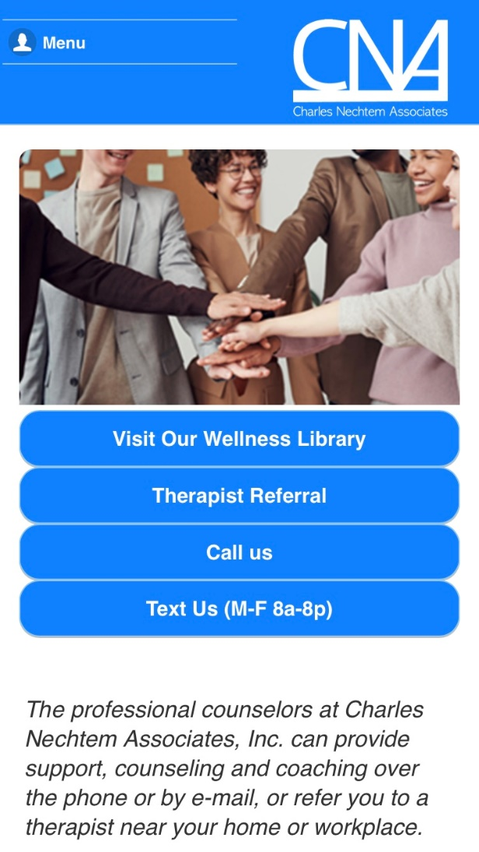
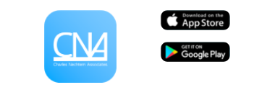
  Mobile APP: Feature
  Call Us 24/7 at 800-531-2040
  Email your concern at inquires@charlesnechtem.com
  Text us and/or schedule a virtual appointment with and EAP counselor at your convenience
  Submit your therapist referral questionnaire and the counselor will you 3 matched therapists via your preferred contact method
  Access interactive self-help wellness library with 25,000 resources
  *CNA Assistance Apps are available at the Apple Store and Google Play
www.charlesnechtem.com
2
Notes:
This is just a sample of what you would see when you log into our library.

Slide 20
Employee Assistance Program
1-800-531-0200
www.charlesnechtem.com
Notes:
Our EAP and Work/Life services and procedures provide early, skilled intervention that includes easy access, rapid response, accurate diagnosis, problem resolution, timely referrals, and education.
Thank you for your time and don’t hesitate to call us with any questions you may have!

